Slide 1
DraftCheck- Web Application for Article Analysis
Project Guide:
Dr. N. Rajasekhar
Professor, IT
Team Members:
R. Lohitaa (17241A12G4)
K. Deepthi Reddy (17241A12D3)
M. Sreethi (17241A12E3)
J. Padma Priya (17241A12D1)

Slide 2
Contents
Abstract
Related Work
Proposed Approach
Requirements
Design and Implementation
UML Diagrams
System Approach

Slide 3
Contents
Modules
Implementation
Software Testing
Results
Conclusion
Future Work
Bibliography

Slide 4
ABSTRACT
Digitisation is the process of converting information from physical formats into a digital one so that we can increase data quality and apply advanced techniques like summarising, extracting keywords etc.
Text or article summarization refers to the technique of shortening long pieces of text. The intention is to create a coherent and fluent summary having only main points outlined in the document.
Similarly keyword extraction process not only separates the articles but also helps in saving time when we are searching for a document.Also when there is a limit on the number of words that can be used in a document, we need the help of a word counter.
DraftCheck provides a single platform for all the analysis tasks of articles.

Slide 5
RELATED WORK
The existing systems have a different approach towards analysing articles. Through our sources we have observed that the existing applications cater to very specific needs such as counting words or extracting keywords.
But when it comes to an application that has multiple functionalities and could serve as the one stop solution for finalising or improving drafts, thesis or dissertations, there are not a lot of applications on the web that are doing it, efficiently.
Sites like Smmry, Resoomer, Scholarcy etc. do the job of summarising articles but we aim at providing more accurate summaries along with other ways of analysing the articles.

Slide 6
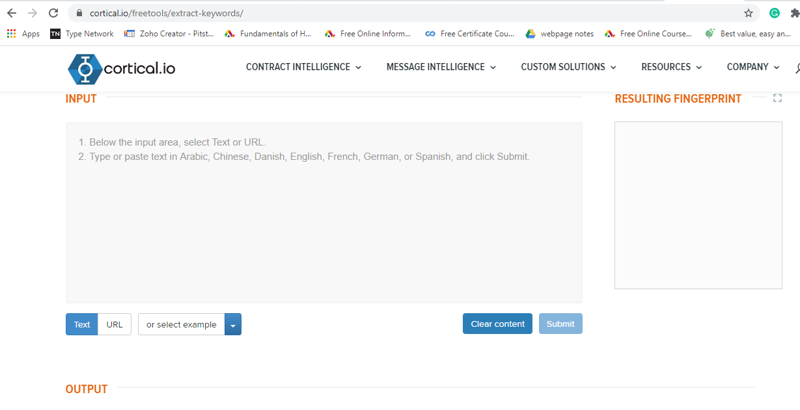
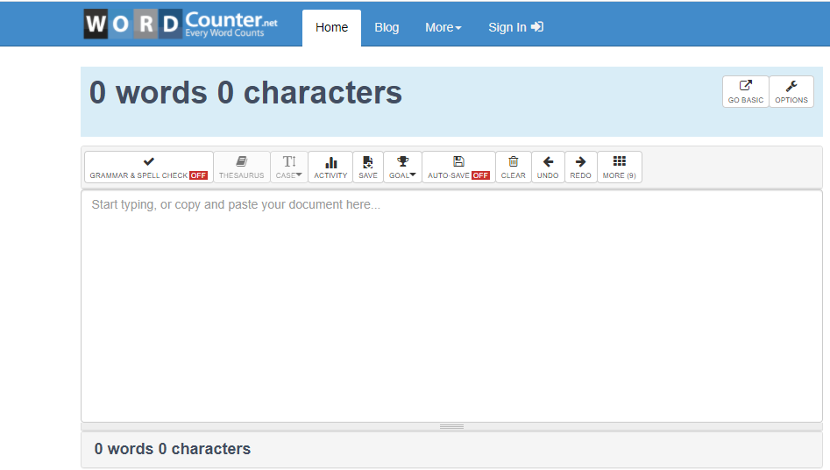
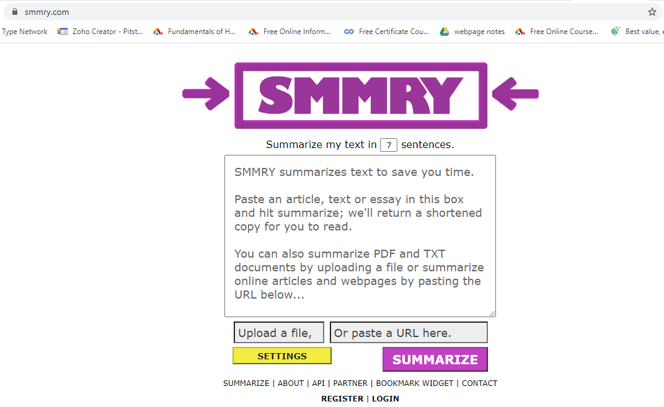

Slide 7
PROPOSED APPROACH
Our application will first require the user to select one of the options of analysing. Next, the user will be requested to provide the url of the website he/she is using as a source or paste the article itself in the textbox.
Summarization: An Adaptive Text Summarization API will be used to summarize the article
Keyword Extraction: We will use NLP to extract keywords from the provided article
Word Counter: The application will require a python program for word counter
Spell Check: Using TextBlob package

Slide 8
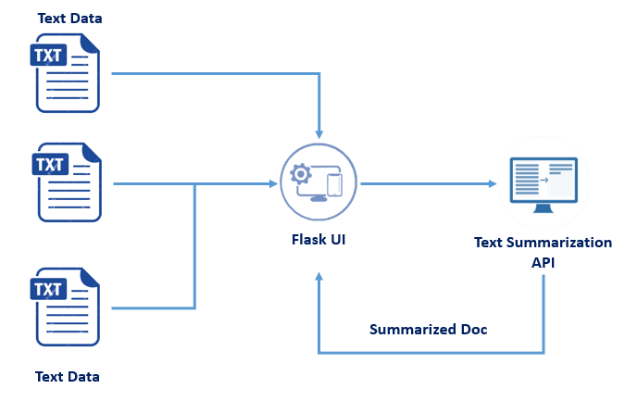

Slide 9
REQUIREMENTS
Software
Anaconda Navigator
Flask
Python
Python Web Frameworks
GitHub
Windows 7 or higher
Hardware
Processor- Core i3
Hard Disk- 160 GB
Memory- 1 GB RAM
Monitor
Camera

Slide 10
Design and Implementation
The steps involved in the functioning of the application are listed below:
The user has to choose an operation that he wishes to perform.
Then he is presented with a screen where he has to provide the data on which he wants to perform the operation.
The user can either provide a link where the data is present or give in the form of text.
The chosen operation is performed on the provided data.
The result is then displayed on the screen.

Slide 11
UML Diagrams
UML diagrams are used to communicate different characteristics of a system. UML diagram serves as a complete design that requires the actual implementation of the software.
There are several types of UML diagrams and each one of them serves a different purpose regardless of whether it is designed before the implementation or after.
The following slides contain diagrams used for this system.

Slide 12
Use-Case
A use-case diagram is used to model dynamic behavior of the system. It contains a set of actors and use-cases.
Actors:
User
Administrator
Use-cases:
Register
Choose an operation
Give parameters
View the results
Manage user data
Manage application
Diagram

Slide 13
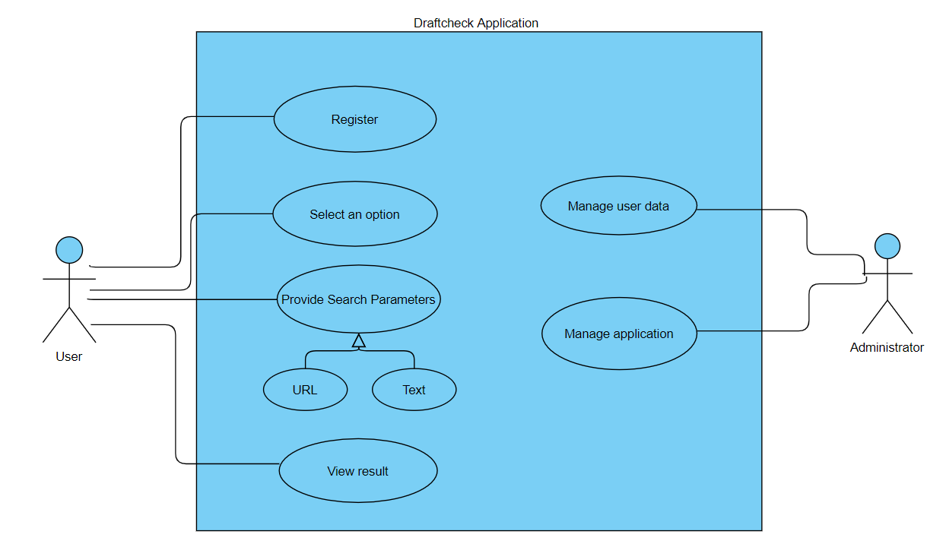
Use-Case Diagram
cg

Slide 14
Activity
An activity diagram is a behavioral diagram. It depicts the control flow from start point to a finish point showing various decision paths that exists while an activity is being executed.
The activities in this system are:
Waiting for an option
Waiting for search parameters
Performing the operation
Displaying the output
Diagram

Slide 15
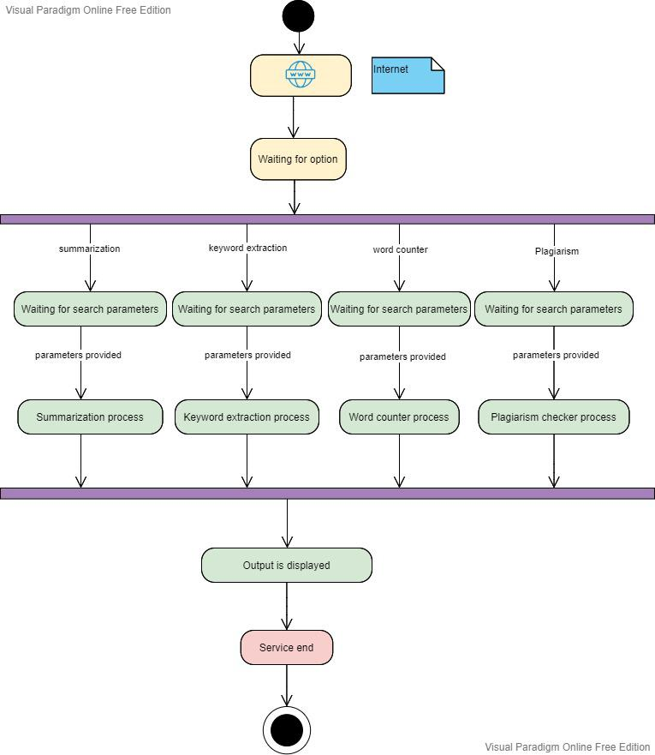

Slide 16
Sequence
A sequence diagram is an interaction diagram. It shows the interaction between objects in a sequential order.
It contains lifelines, objects and messages exchanged between them.
The objects in this system are:
Client browser
Web server
Application and scripts
Diagram

Slide 17
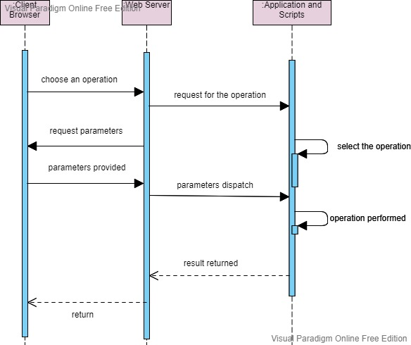
Sequence Diagram
Cl

Slide 18
Collaboration
Collaboration diagram is also an interaction diagram. It illustrates the relationships and interactions between software objects.
The major elements of collaboration diagram are objects, links and messages.
The objects in this system are:
Client browser
Web server
Application and scripts.
Diagram

Slide 19
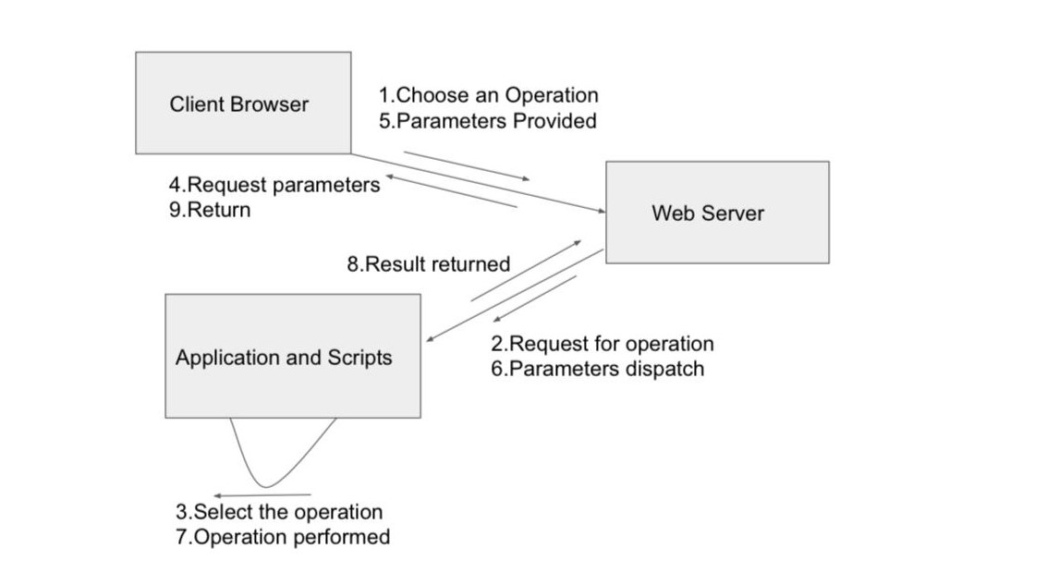
Collaboration Diagram
Cl

Slide 20
Statechart
A statechart diagram models dynamic nature of the system. It defines different states of objects during its lifetime and the events that trigger these changes.
The main elements of statechart diagram are:
Events
States
Transition
Diagram

Slide 21
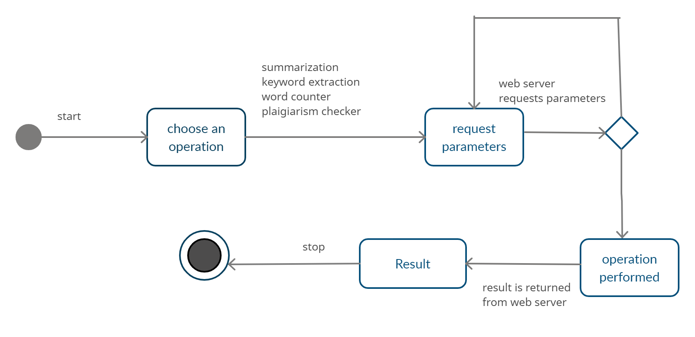
Statechart Diagram
Cl

Slide 22
Workflow
Fig: Workflow for Text Summarization

Slide 23
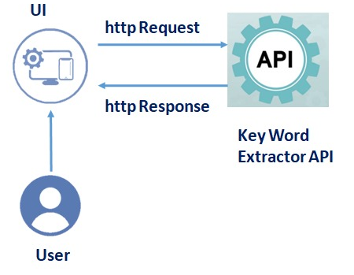
Workflow
Fig: Workflow for Keyword Extraction

Slide 24
System Approach
The DraftCheck web application is developed using a modular approach.
Modular architecture is based on the design and use of systems composed of separate repetitive elements (standard units), which are similar in size, shape and functional nature. These can be linked up to each other, be replaced or added.
In modular approach a complex system is broken into independent modules. These modules can be written in different programming languages as well. The modules are integrated into a system.

Slide 25
Modules
The modules to be included in Draft Check, the website depends on the understanding that there is an abundance of public content available and it will keep increasing every minute, there is a need to make life easier for students and various academicians who have to go through tons of information just to find a few relevant points.
With this understanding, we have identified a few features that could be a part of our application that would cater to our goal of building an application that would be a one-stop solution for various academic and non-academic article analysis situations.

Slide 26
Modules(continued)
We have conducted market-research to understand what students and researchers usually look for when trying to analyse their articles, thesis or dissertations. We have listed a few features that could contribute to our goal.
The result of the system is to analyse articles, thesis, dissertations etc. efficiently.

Slide 27
Article
The first module is Article Summarisation.
Through our research we identified that the abundance in public content makes it harder for researchers to sort through relevant and irrelevant data.
To even know if the article is helpful or not we have to read it till the end to understand what’s discussed.
Therefore we included this feature in our application by summarizing the articles using an Adaptive Text Summarization API.
Summarization

Slide 28
Word
The second module is word counter.
Having to stick to a word limit is not unheard of when writing articles.
When a limit is set, writers are put under an obligation to keep a check at the number of words or characters they use.
For this purpose we added word counter to our application to let users get a count of words in their articles.
Counter

Slide 29
Keyword
The third module is keyword extraction.
Reading twenty, thirty or even a hundred pages to just understand what was discussed in an article takes up so much time.
Researchers have an abundance of information to go through everyday, it gets harder for them especially when they have deadlines to meet.
Extraction

Slide 30
Spell
To recheck each and every spelling and make the required corrections could take up a lot of time and for this reason we have included another option on our application that lets our users paste their articles in the textbox provided.
On clicking the spell check button, the user will be provided with their article that has been checked for incorrect spellings and been corrected.
Checking

Slide 31
Implementation
DraftCheck is a web application. We need an application interface to allow communication between multiple applications.
We need to understand that a software intermediary needs to exist for two applications to communicate with each other.
Imagine you are checking weather or using an App for instant messaging, so what you are doing is using an API (Application Programming Interface).
If you send a request to the provider, the API delivers it to the provider and returns with the response from the provider.

Slide 32
Implementation(continued)
To run the application firstly, all of our files were stored in the same folder named Article. The templates folder contains all the html files. And the Article Summarizer folder also contains the python file named app.py that’ll run our application.
Within the templates folder all the html files are stored. Each html file takes the application to a web page designed for its purpose.
For example, the summary file takes you the webpage for summarising the article given through the url given by the user and the summarizer file takes you to the webpage that allows the user to provide the article in the form of text in the textbox.

Slide 33
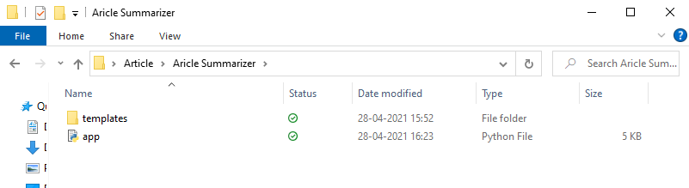
Implementation(Continued)
The Article Folder :

Slide 34
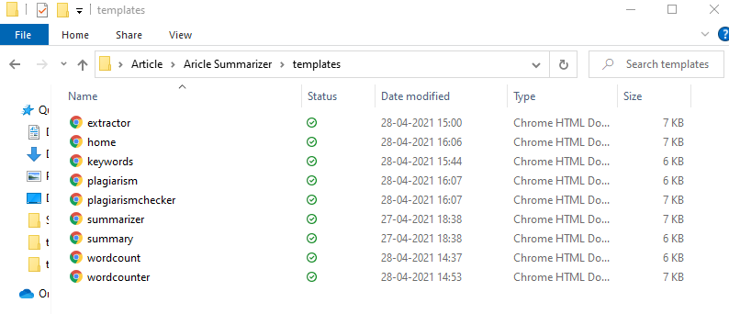
Implementation(Continued)
The template folder :

Slide 35
Implementation(Continued)
Anaconda Navigator:
Anaconda Navigator is used to launch the python programs and manage the conda code.
Python is an interpreted language, so, one can take its full advantage by running a few lines of code and see and understand what’s happening, step by step.
This can be achieved by using Jupyter Notebook.
Flask in Python :
Flask is a third-party Python library for developing Python web applications.
It establishes more control over the components such as databases and lets you interact with them. It made DraftCheck flexible and fast.
Install Flask by running the following command in the command prompt.
pip install flask

Slide 36
Software Testing
The purpose of testing is to discover errors. Testing is the process of trying to discover every possible fault or weakness in a work product. It is the process of exercising software with an intent of ensuring that the system meets its requirements and user expectations and does not fail in an unacceptable manner.
Most of the time, the end user might not be equipped with technical knowledge and hence it is important that the developers think from the end user point of view as well.
The application or system will be tested in an environment similar to where it will be deployed. Thus it helps us to find out all possible ways in which the application can fail when used by the end user.

Slide 37
Test Objectives
The following are the test objectives :
All the methods and algorithms used must function properly.
Validate the output returned.
Test how the system performs in unprecedented conditions.

Slide 38
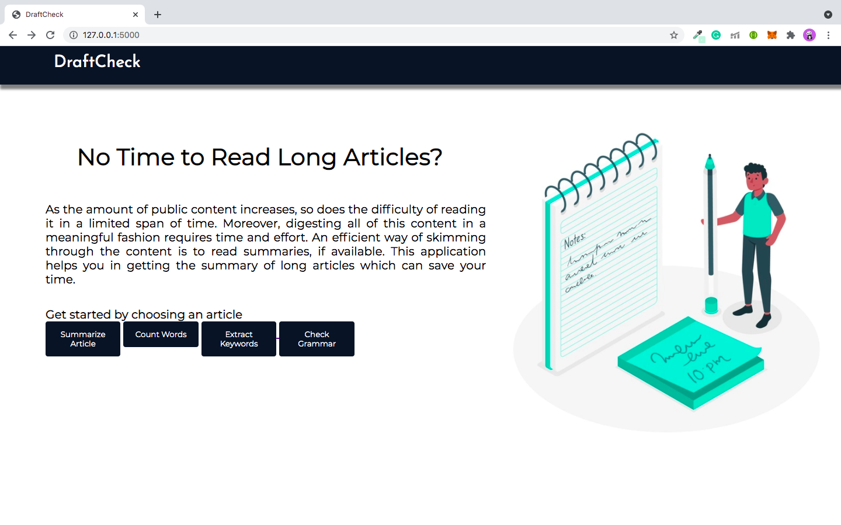
Results
The image below shows the homepage of the application.

Slide 39
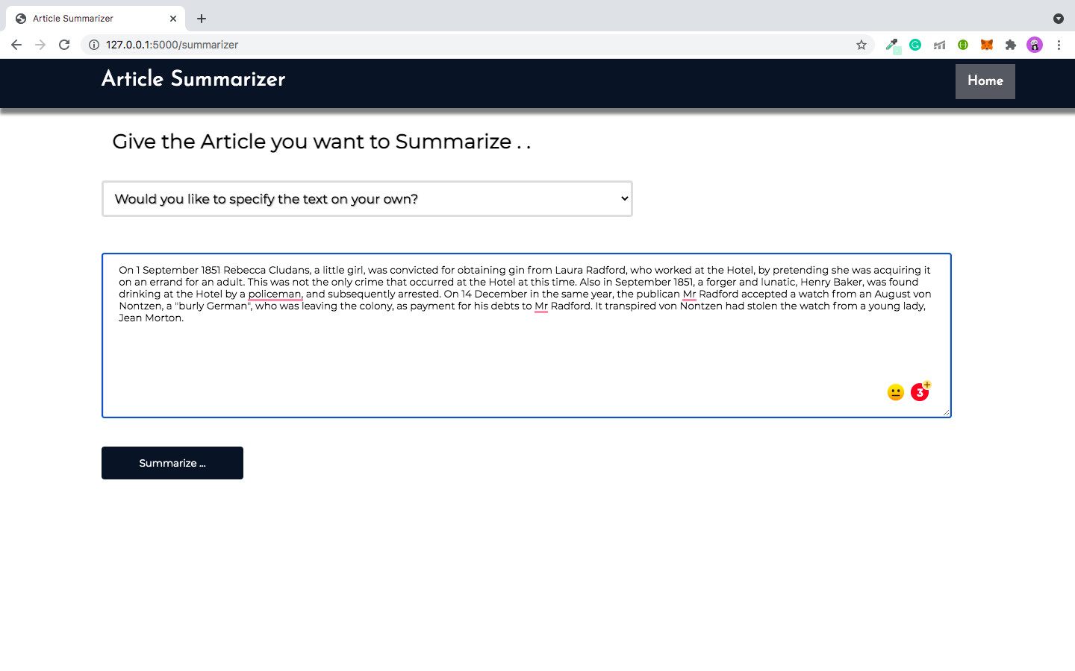
The following image shows the webpage that provides the user with a textbox to paste his article.

Slide 40
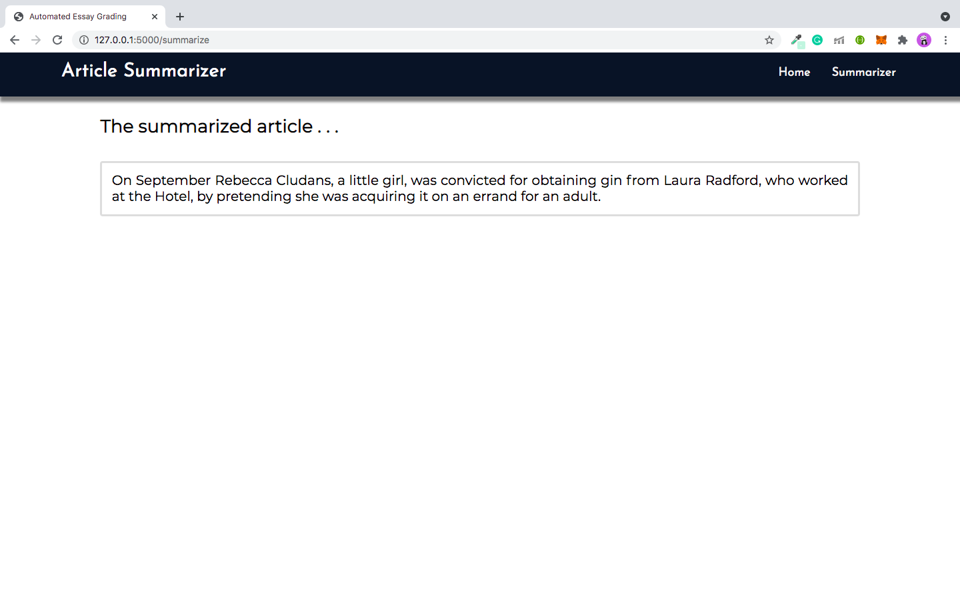
The image below shows the summary of the article provided by the user in the textbox image below shows the summary of the article provided by the user in the textbox
The image below shows the word count of the article provided by the user in the textbox.

Slide 41
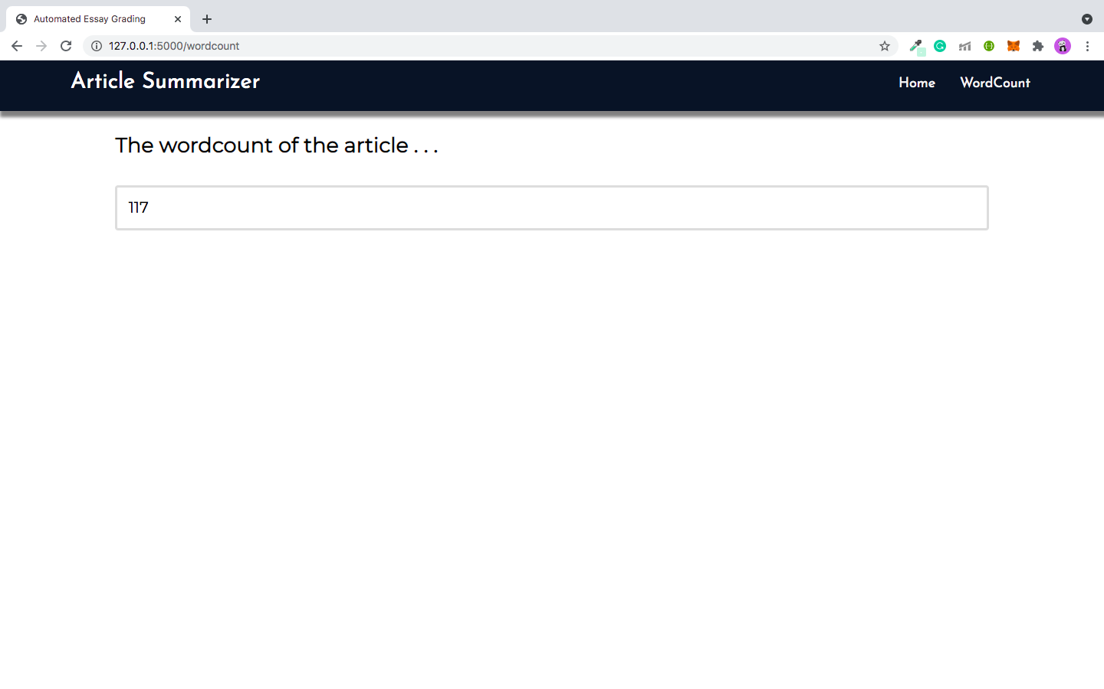
The image below shows the word count of the article provided by the user in the textbox.
The image below shows the word count of the article provided by the user in the textbox.
The image below shows the word count of the article provided by the user in the textbox.

Slide 42
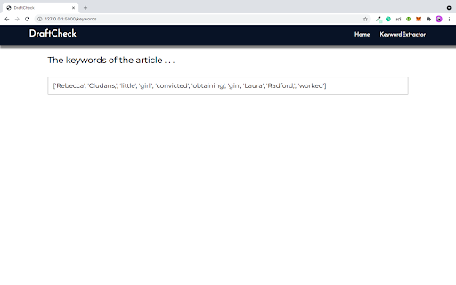
The image below shows the keywords of the article provided by the user in the textbox.

Slide 43
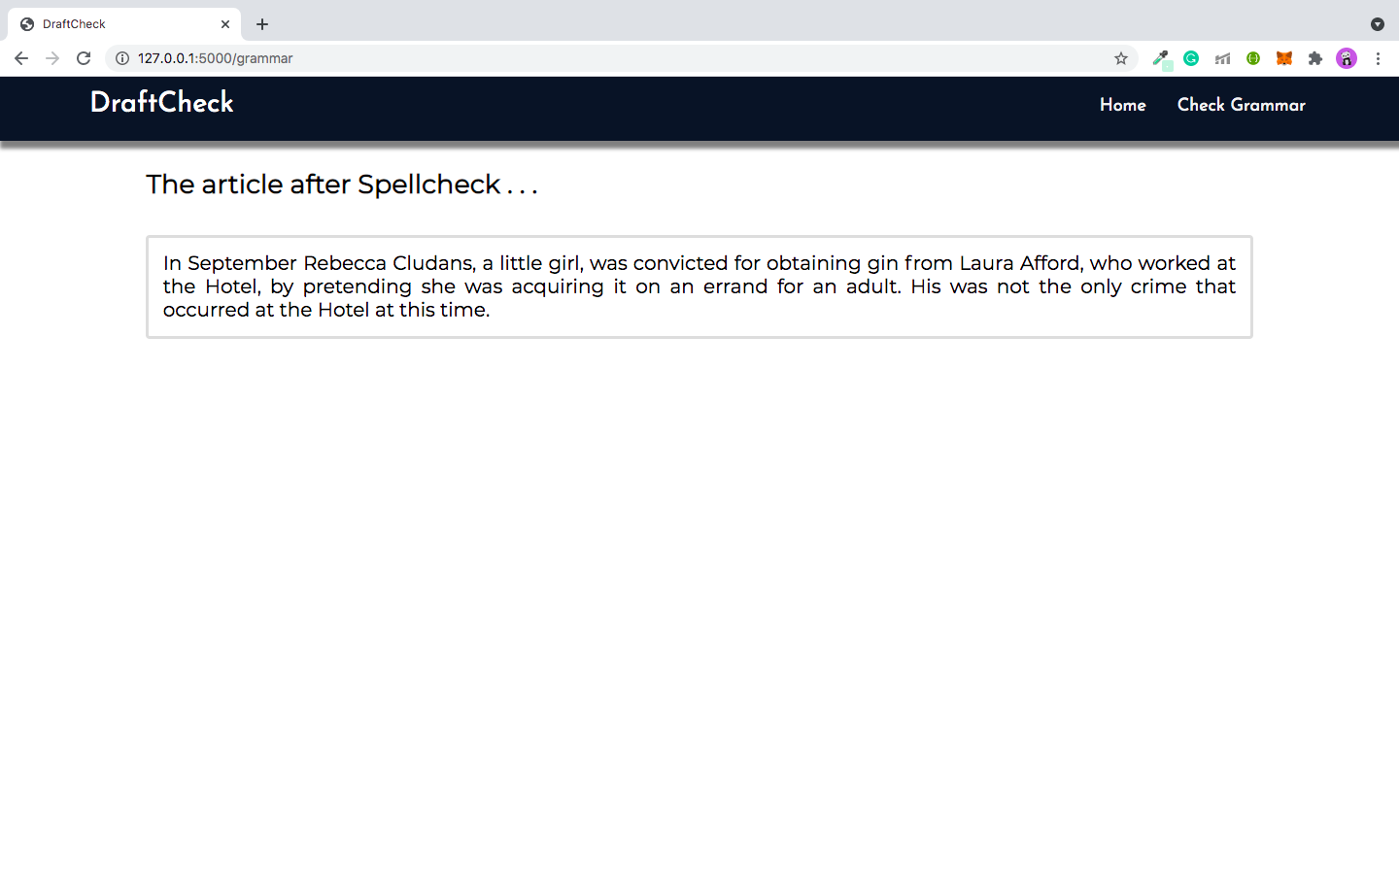
The image below is the output after spell checking the article provided by the user in the textbox.

Slide 44
Conclusion
Our application, DraftCheck has functioned the way we initially expected it to. The options, summarize an article article, word count, keyword extraction and spell check, that we have provided on our application have worked well with the articles that were pasted in the textbox provided.The word counter worked well with the data provided. The keyword extractor is currently extracting keywords based on the TF-IDF score and has given us the results only based on it but we believe we can further research methods that would give better results.
Therefore, we believe that our application has a great scope in the real-time world and provides a platform for further improvement and many more additions that would benefit researchers, students, academicians and many more.

Slide 45
Future Work
The future development of this application is endless.
Integrating other article analysing tasks such as plagiarism checking, grammar checking , spell checking etc helps the user to perform various tasks accurately at one place. This makes the life easier for the user as he need not search for sites to perform each one of these tasks
Making DraftCheck available as a mobile application can make it more user friendly. This saves user time.
Once he downloads the application he can use it any time unlike web applications where he should load the link/url to the web app every time he wishes to perform a task.

Slide 46
Future Work (continued)
Another possible development of DraftCheck is making it available in multiple languages. Although the application currently performs operations only on articles and documents written in english language, developing it to handle articles written in multiple languages can be an added advantage.
This increases the complexity of the application. But if implemented the number of users of the application will increase.
These are the possible future developments on DraftCheck.

Slide 47
BIBLIOGRAPHY
https://stackoverflow.com/questions/1193408/how-to-develop-a-plagiarism-detector
https://smmry.com/
http://freesummarizer.com/
https://wordcounter.net/
https://www.docsvault.com/features/document-scanning-digitization/#:~:text=In%20document%20management%2C%20Document%20Scanning,repository%20for%20easy%20retrieval%20later.
https://en.wikipedia.org/wiki/Optical_character_recognition
https://nanonets.com/document-digitization

Slide 48
Thank You!

